Slide 1
What is a monarchy? (mon-ah-kee)

Slide 2
What is a monarchy?
A monarchy is a type of government that has a single person known as a monarch at its head. Monarchs use titles such as king, queen, emperor or empress.
Monarchies used to be very popular around the world, but now they are very rare.
We are one of the countries that still has a monarchy.

Slide 3
The person who rules over a country and leads the monarchy is call a monarch.
Who is the monarch of our country?

Slide 4
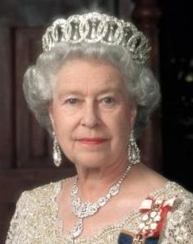
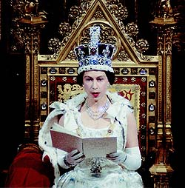
Her Majesty Queen
Elizabeth II

Slide 5
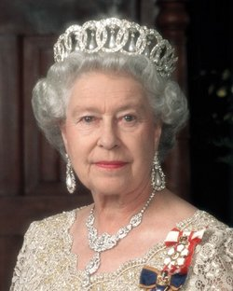
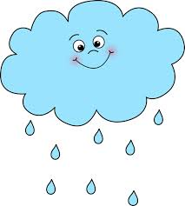
How long a king or queen rules over a country is a called their ‘reign’.
It is pronounced exactly the same as ‘rain’.

Slide 6
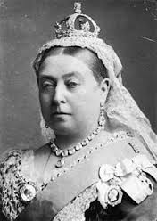
The longest reigning monarch was our current Queen’s great, great grandmother Queen Victoria, who reigned for 63 years and 216 days from 1837 -1901.

Slide 7
She is the reason why we have a period in our history call the ‘Victorian Times’.
She was only five feet tall, but was known to be quite fierce!
After her husband Prince Albert died she always wore black.

Slide 8
Today, Wednesday 9th September 2015, is a very special day for the Queen Elizabeth II because she has become the longest reigning British monarch in history as this is her 63 years and 217th day as Queen!

Slide 9
What is she doing to celebrate?
Out of respect for her great, great Grandmother the Queen has requested that there be no big celebrations.
She is expected to make a rare public speech where she will thank everyone for their support.
She will have a family meal in the evening

Slide 10
Let us finish with some fun facts…
During her reign she has sat down to have pictures painted of her at least 129 times!
Her head appears on every British coin
Her official Facebook page has over 1 million likes
Her full title as Queen is “Her Majesty Elizabeth the Second, by the Grace of God
She does not have a passport! As all passports are issued in her name she does not need one!

Slide 11
A moment of reflection

Slide 14
Born on 21st April 1926 to the Duke and Duchess of York...

Slide 15
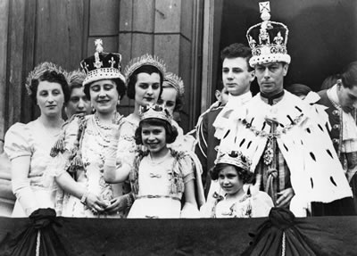
In 1937 Elizabeth went to the coronation of her parents King George VI and Queen Elizabeth. She was 11.

Slide 16
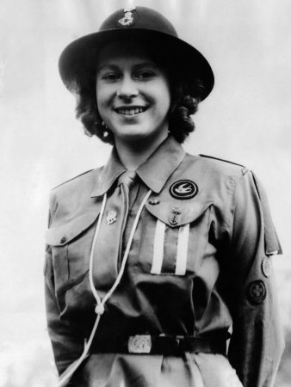
She also became a girl guide when she was 11.

Slide 17
In 1947 Elizabeth got engaged, and then married, to Lieutenant Philip Mountbatten. He was then called the Duke of Edinburgh.

Slide 18
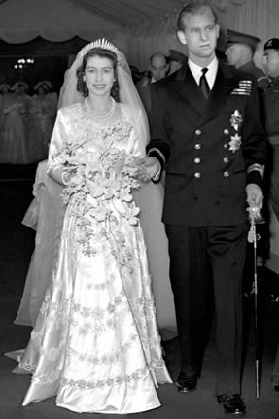
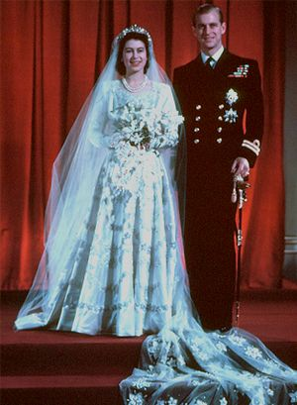

Slide 19
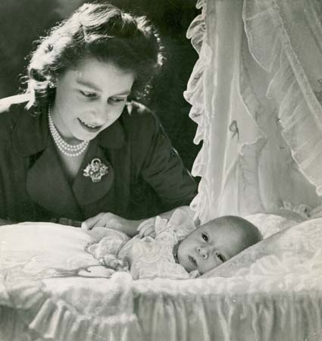
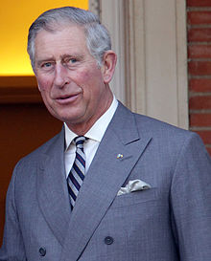
Elizabeth had her first child, Prince Charles, in November 1948.

Slide 20
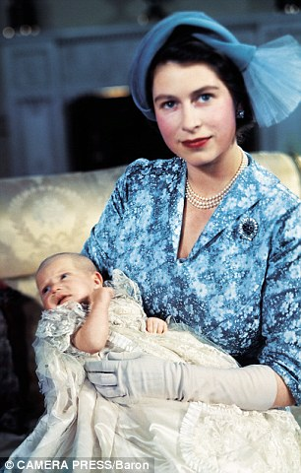
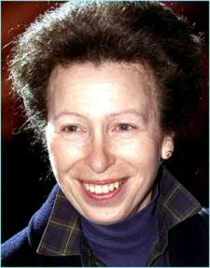
Princess Anne was born two years later in 1950.

Slide 21
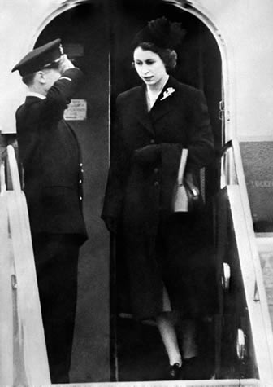
In 1952 Princess Elizabeth was on holiday with her family when she heard her father, the King, had died. She arrived back in England as Queen.

Slide 22
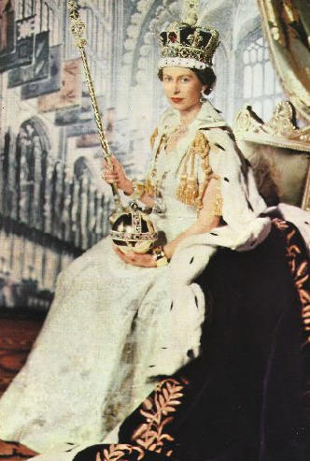
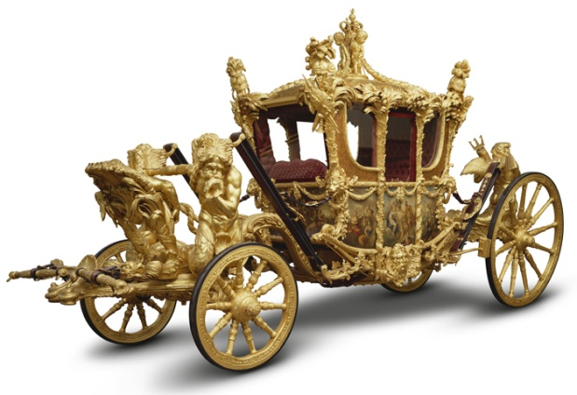
2nd June 1953 was the official coronation of Queen Elizabeth II.

Slide 23
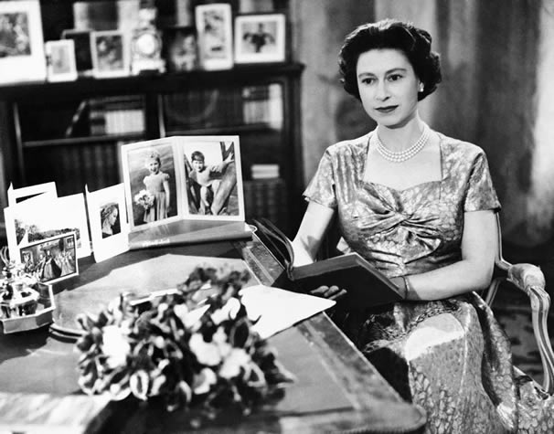
In 1957 the Queen gave her first televised Christmas message to the nation.

Slide 24
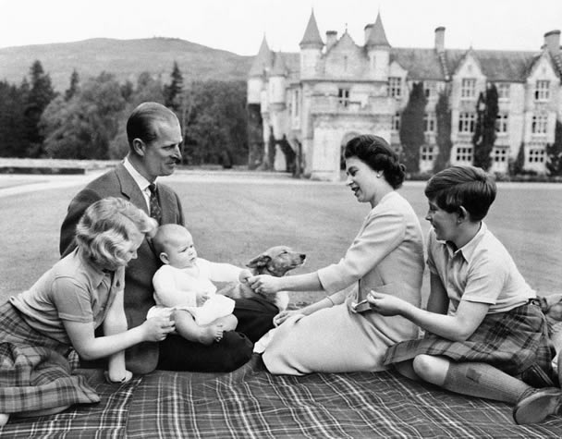
In 1960 Prince Andrew was born.

Slide 25
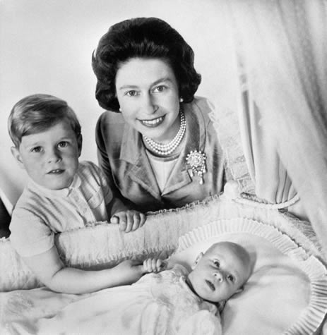
In 1964 Prince Edward was born.

Slide 26
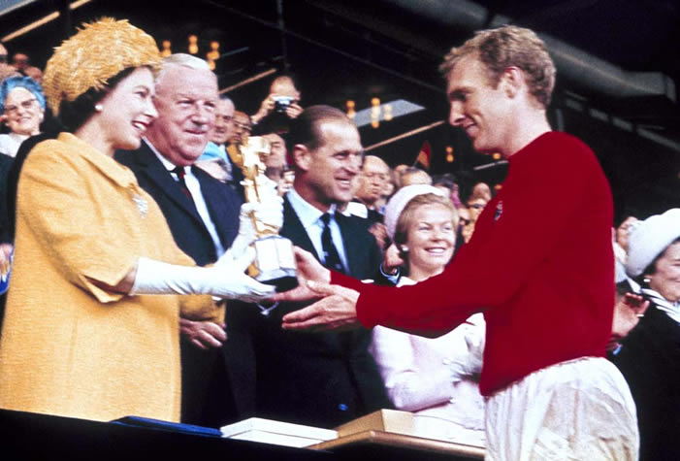
In 1966 Queen Elizabeth watched England win the world cup!

Slide 27
In 1970 Queen Elizabeth, Prince Charles and Princess Anne watched the first Commonwealth Games in Edinburgh.

Slide 28
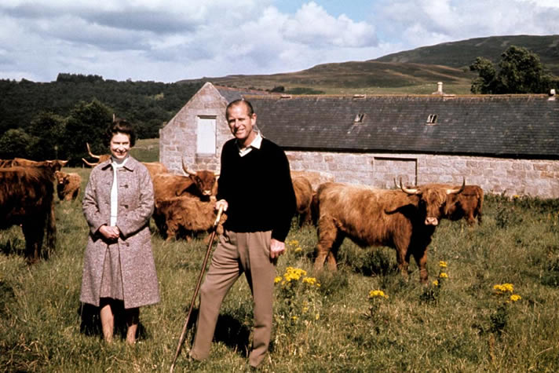
In 1972 Queen Elizabeth and Prince Philip celebrated 25 years of marriage.

Slide 29
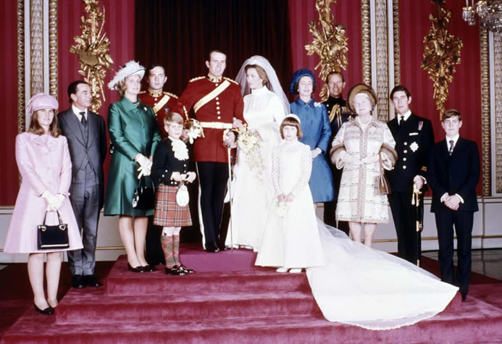
In 1973 Queen Elizabeth saw her daughter, Princess Anne, get married.

Slide 30
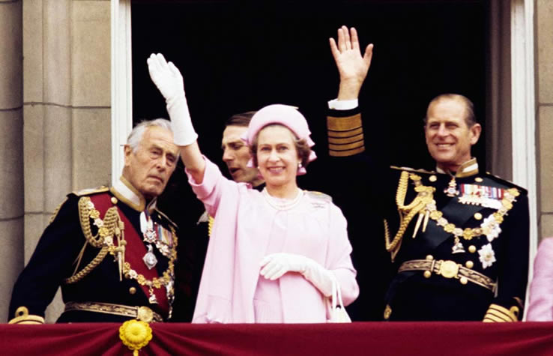
In 1977 the Queen celebrated her Silver Jubilee – on the throne for 25 years.

Slide 31
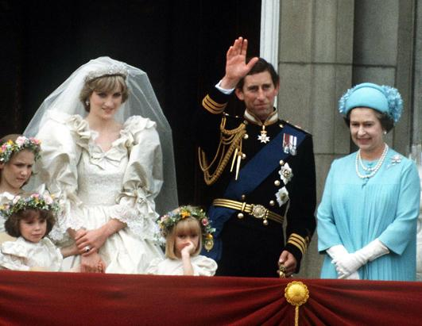
In 1981 the Queen attended the wedding of Prince Charles and Princess Diana.

Slide 32
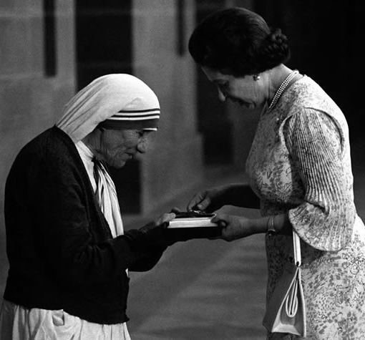
The Queen has met many famous people. This is her meeting Mother Teresa in 1983.

Slide 33
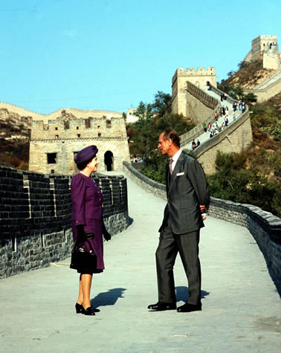
The Queen and Prince Philip toured around China in 1986.

Slide 34
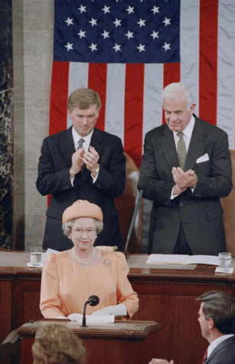
The Queen addressed the Congress in America in 1991.

Slide 35
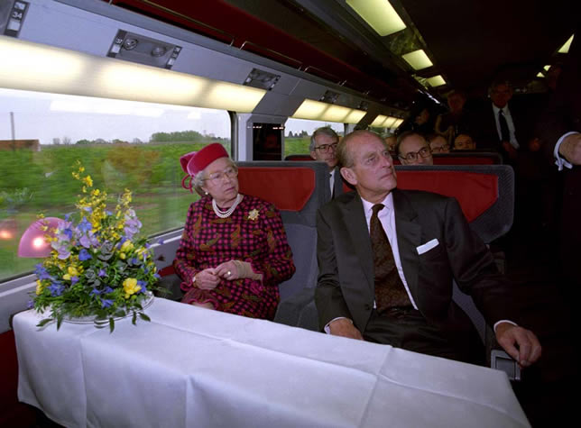
When Eurostar opened in 1994 Queen Elizabeth was on the first train!

Slide 36
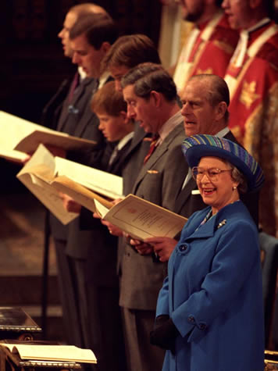
In 1997 Queen Elizabeth and Prince Philip celebrated 50 years of marriage.

Slide 37
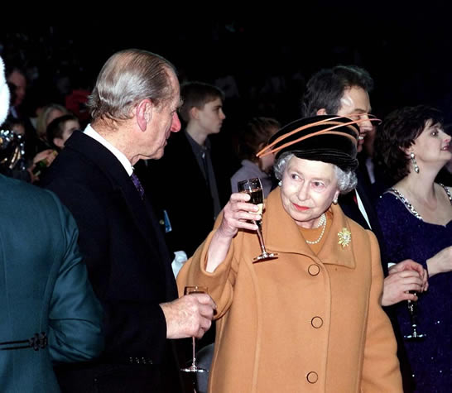
At the end of 1999 the Queen welcomed in the new millenium.

Slide 38
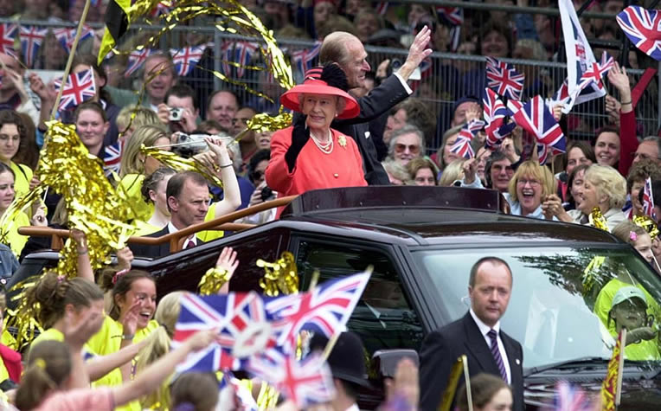
Golden Jubilee 2002

Slide 39
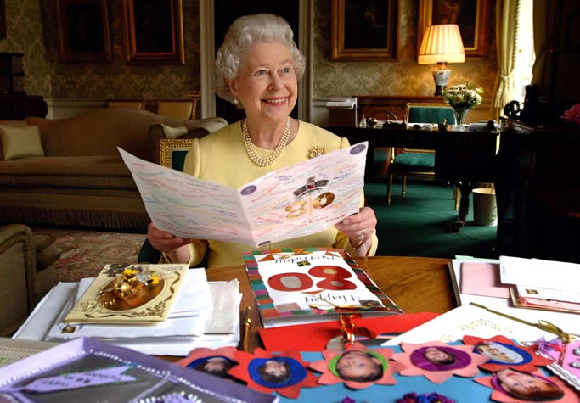
Queen Elizabeth turned 80 in 2006.

Slide 40
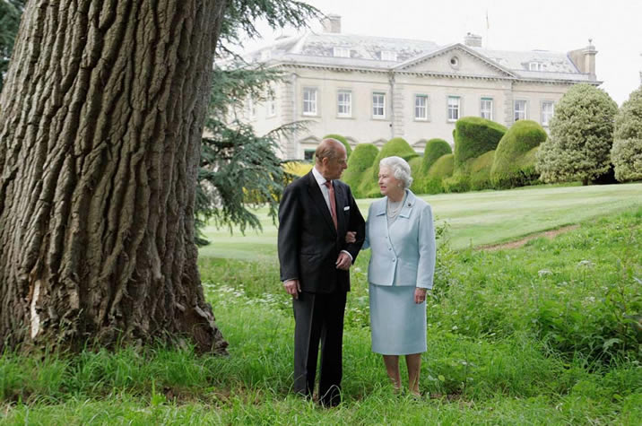
Married for 60 years in 2007.

Slide 41
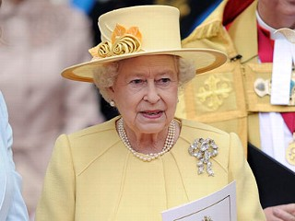
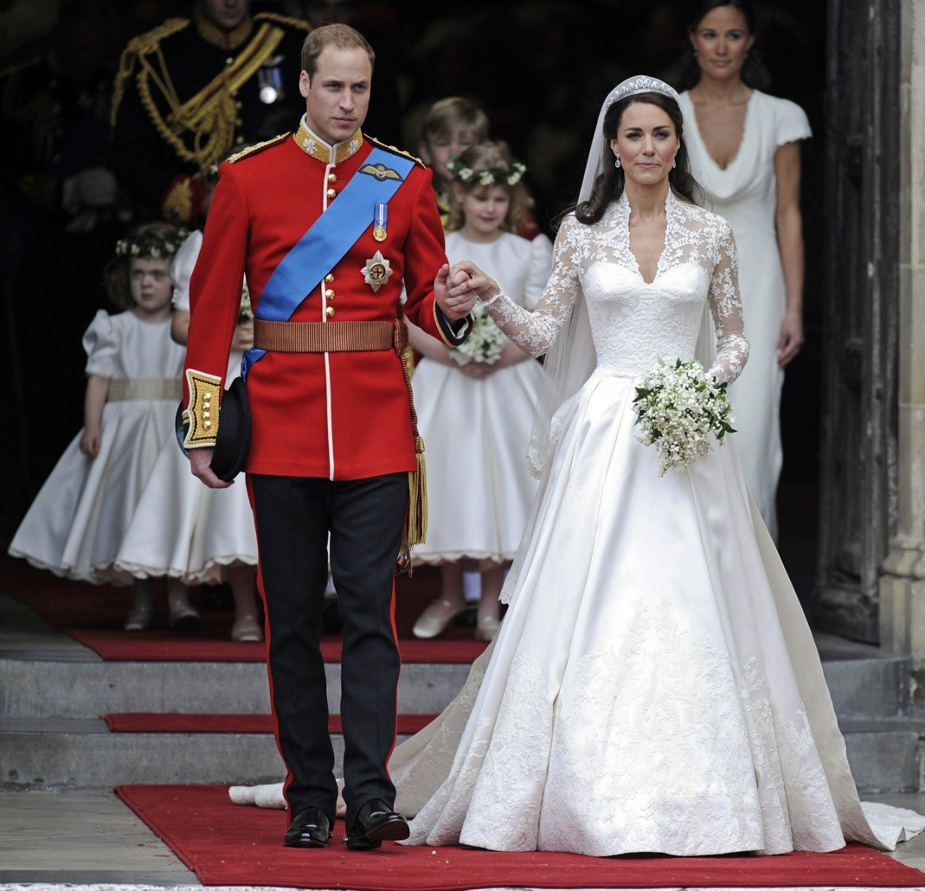
In 2011 Queen Elizabeth watched her grandson get married.

Slide 42
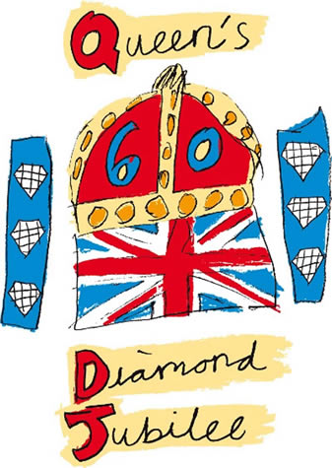
Diamond Jubilee 2012

