Slide 1
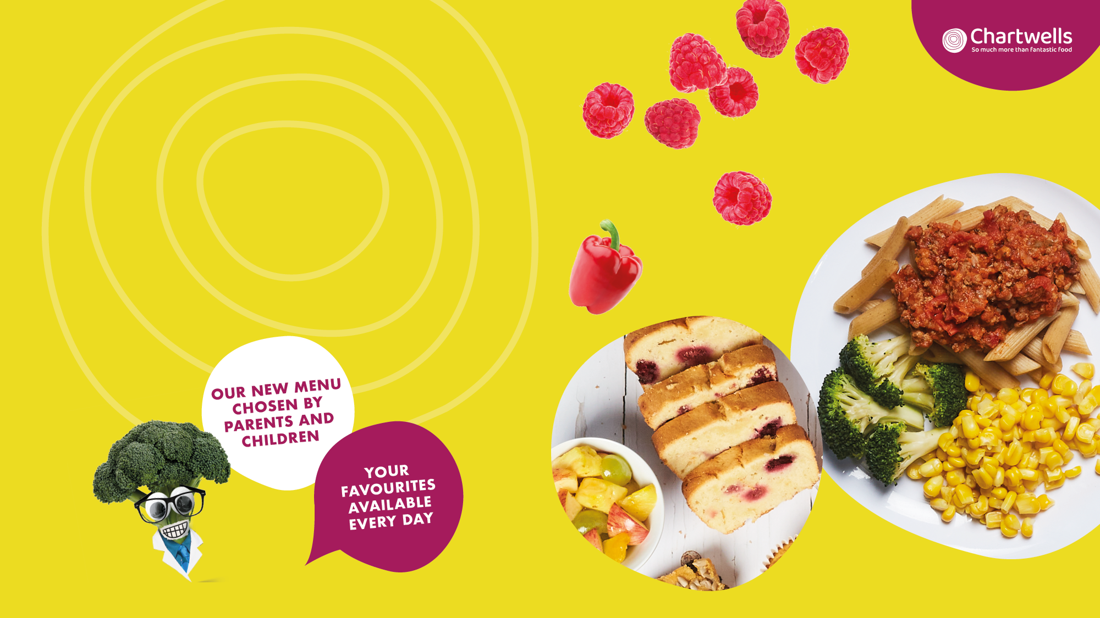

Slide 2








WEEK 1
MENU
W/C: 18/04, 09/05, 06/06, 27/06, 18/07,
19/09, 10/10
MONDAY
TUESDAY
WEDNESDAY
THURSDAY
FRIDAY
Hot Main Dish | Chinese Veggie Noodles | Chicken Korma with Rice | Roast Chicken with Roast Potatoes and Gravy Succulent roast chicken with fluffy roasties and tasty gravy | Lamb Keema Curry with Rice | Golden Fish Fingers and Chips Crispy fish fingers and scrummy chips
Alternative Dish | Macaroni Cheese Cheesy macaroni pasta | The Incredible Burger with Potato Wedges | Quorn Roast | Quorn Hot Dog with Potato Wedges | Quorn Dippers and Chips Crispy Quorn nuggets
Salads | A Selection of Fresh Salads Including lettuce, cucumber, tomato, grated carrot | A Selection of Fresh Salads Including lettuce, cucumber, tomato, grated carrot | A Selection of Fresh Salads Including lettuce, cucumber, tomato, grated carrot | A Selection of Fresh Salads Including lettuce, cucumber, tomato, grated carrot | A Selection of Fresh Salads Including lettuce, cucumber, tomato, grated carrot
Jacket Potato | Jacket Potato with a choice of fillings | Jacket Potato with salmon mayonnaise and a choice of fillings | Jacket Potato with a choice of fillings | Jacket Potato with a choice of fillings | Jacket Potato with a choice of fillings
Pasta | Tomato Pasta A delicious fresh, homemade tomato sauce with penne pasta | Tomato Pasta A delicious fresh, homemade tomato sauce with penne pasta | Tomato Pasta A delicious fresh, homemade tomato sauce with penne pasta | Tomato Pasta A delicious fresh, homemade tomato sauce with penne pasta | Tomato Pasta A delicious fresh, homemade tomato sauce with penne pasta
Vegetables | Green Beans and Sweetcorn | Peas and Broccoli | Carrots and Cabbage | Broccoli and Sweetcorn | Baked Beans and Peas
Desserts | Raspberry Ripple Ice Cream | Secret Brownie | Shortbread Biscuit with Fruit Slices | Berry and Peach Oaty Crumble with Custard | Lemon Slice

Slide 3
WEEK 2
MENU
W/C: 25/04, 16/05, 13/06, 04/07, 05/09, 26/09, 17/10
MONDAY
TUESDAY
WEDNESDAY
THURSDAY
FRIDAY
Hot Main Dish | Vegetable Biryani | Allegra’s Crispy Chicken, Stomp Mash & Onion Gravy | Roast Turkey with Roast Potatoes and Gravy Succulent roast turkey with fluffy roasties and tasty gravy | Cottage Pie | Herby Roast Fish With Chips
Alternative Dish | Cheese and Tomato Pizza with Dough Balls Cheesy tomato topped pizza slice | The Incredible Burger with Potato Wedges | Sweet Potato Chickpea Roast | Veggie Balls In Tomato Sauce with Pasta | Quorn Dippers
Salads | A Selection of Fresh Salads Including lettuce, cucumber, tomato, grated carrot | A Selection of Fresh Salads Including lettuce, cucumber, tomato, grated carrot | A Selection of Fresh Salads Including lettuce, cucumber, tomato, grated carrot | A Selection of Fresh Salads Including lettuce, cucumber, tomato, grated carrot | A Selection of Fresh Salads Including lettuce, cucumber, tomato, grated carrot
Jacket Potato | Jacket Potato With a choice of fillings | Jacket Potato With a choice of fillings | Jacket Potato With a choice of fillings | Jacket Potato With a choice of fillings | Jacket Potato With a choice of fillings
Pasta | Tomato Pasta A delicious fresh, homemade tomato sauce with penne pasta | Tomato Pasta A delicious fresh, homemade tomato sauce with penne pasta | Tomato Pasta A delicious fresh, homemade tomato sauce with penne pasta | Tomato Pasta A delicious fresh, homemade tomato sauce with penne pasta | Tomato Pasta A delicious fresh, homemade tomato sauce with penne pasta
Vegetables | Carrot Sticks and Cucumber Sticks | Peas and Broccoli | Carrots and Cabbage | Green Beans and Sweetcorn | Baked Beans and Peas
Desserts | Apple and Berry Crumble & Custard | Fruity Flapjack Bar | Banana and Carrot Slice | Fruity Chocolate Brownie | Vanilla Ice Cream

Slide 4
WEEK 3
MENU
W/C: 02/05, 23/05, 20/06, 11/07, 12/09, 03/10
MONDAY
TUESDAY
WEDNESDAY
THURSDAY
FRIDAY
Hot Main Dish | Macaroni Cheese Cheesy Macaroni Pasta | Allegra Chicken, Potato Bites & Pizza Sauce Seasoned Chicken served with Pizza Potatoes | Jerk Chicken with Potato Wedges | Beef Lasagne with a Garlic & Herb Bread Wedge | Herby Roast Fish and scrummy chips
Alternative Dish | Veggie Pasta Bolognese | Veggie Balls In Tomato Sauce with Pasta | Butternut Squash and Potato Pastry Slice with Roast Potatoes and Gravy A chunky butternut squash and potato slice | Veggie Korma with Bombay Potato | Quorn Dippers
Salads | A Selection of Fresh Salads Including lettuce, cucumber, tomato, grated carrot | A Selection of Fresh Salads Including lettuce, cucumber, tomato, grated carrot | A Selection of Fresh Salads Including lettuce, cucumber, tomato, grated carrot | A Selection of Fresh Salads Including lettuce, cucumber, tomato, grated carrot | A Selection of Fresh Salads Including lettuce, cucumber, tomato, grated carrot
Jacket Potato | Jacket Potato With a choice of fillings | Jacket Potato With a choice of fillings | Jacket Potato With a choice of fillings | Jacket Potato With a choice of fillings | Jacket Potato With a choice of fillings
Pasta | Tomato Pasta A delicious fresh, homemade tomato sauce with penne pasta | Tomato Pasta A delicious fresh, homemade tomato sauce with penne pasta | Tomato Pasta A delicious fresh, homemade tomato sauce with penne pasta | Tomato Pasta A delicious fresh, homemade tomato sauce with penne pasta | Tomato Pasta A delicious fresh, homemade tomato sauce with penne pasta
Vegetables | Peas and Carrots | Sweetcorn and Broccoli | Carrots and Cabbage | Green Beans and Sweetcorn | Baked Beans and Peas
Desserts | Oatie Biscuit with Fruit Slices | Pineapple and Peach Crumble with Custard | Strawberry Ice Cream | Chocolate Sponge Cake | Cheese & Biscuits Cheddar Portion

